Slide 1
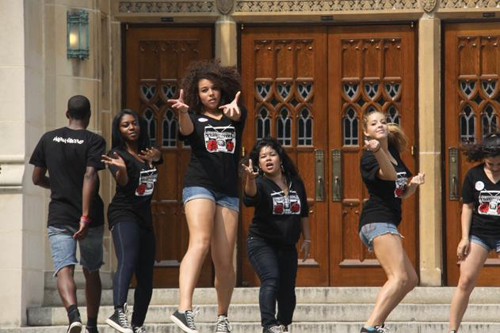
FY21 PAAC Appeal
By: Matt Loria

Slide 2
$75,000
PAAC Appeal Request for:

Slide 3
Addition of FOUR New (Dance) Groups
SAMPLE DANCE GROUP REQUESTS
GU Dance Company:
$11,950 (Expenses- Tickets/ads)
Black Movement Dance Theatre
$12,848 (Expenses-Tickets/ads)
Ritmo and Sabor
$3,354 (Expenses-Tickets/ads)
Ballet Folklorico
$6,445 (Expenses-Tickets/ads)
We are expecting to add four new dance groups to PAAC this spring.
We haven’t added groups in the past ⅘ years.
On average dance groups request $7,900 for yearly programming

Slide 4
Changes to Reflect Accurate Ticketing
- Expected Group Expenses for FY21 (of current PAAC groups): $142,000
- Addition of four dance groups: $29,200
- Total Ticket Sales / Income: $61,348
- Other Income (Coke Grant + Student Affairs): $35,053
TOTAL BALANCE (without GUSA): -$74,799

Slide 5
Example Ad Hoc Funding
Record one full-length album:
Tour or compete at a location accessible by plane:
Rent a DPAC theatre space:
Costumes for a dance performance:
Replace an electric keyboard:
Buy Chairs for Theater:
$9,000
$6,000
$2,000
$600
$1,200
$5,000

Slide 6
Budget Cuts: If allocated at $50,000
As seen previously, an allocation of $50,000 would leave PAAC at (-$25,000) for Regular Season Programming.
Ad Hoc is on average $31,000. But, if allocated $50,000 we would more likely allocate around $15,000.
Total expected loss if allocated at $50,000 would be: 25,000 +15,000=
-$40,000

Slide 7
FY21 Mission & Changes in FY20
Compared to other institutions, Georgetown’s performing arts groups do not have the same range of experiences students at other universities have, disadvantaging those with professional pursuits as well as those who simply have intrinsically positive experiences in the arts.
PAAC has been changing all policies under GUSA guidance to foster open opportunities for our groups to explore events outside of their regular programming and to support student leaders. Our policies are there to help ensure student money is being allocated to the best of its abilities among the arts.
Maintaining a full allocation of $75,000 allows us to financially back this pursuit and ensure all regular season programming can happen as scheduled.

